Slide 1

Search Functionality
Search Functionality using Django

Slide 2
Creating and Activating a Virtual Environment
Creating
`python –m venv venv` in Windows
`python3 –m venv venv` in Linux and Mac
Activating
`.\venv\Scripts\activate` in Windows
`source venv/bin/activate` in Linux

Slide 3
Creating a project and start an App
Creating a Project
`django-admin startproject django_project .` in both Windows, Linux or Mac Computer.
Starting an App
`python manage.py startapp search` in all Computers

Slide 4

Adding App to Installed Apps under settings.py
Let's add our app to settings.py in our project and add a urls.py file to our app

Slide 5
Models for Our Project(Book)
Fields:
Name
Author
Date Published
Synopsis

Slide 6
Creating Our Home Page
Create a View For The Home Page
And Add URL to access the homepage

Slide 7
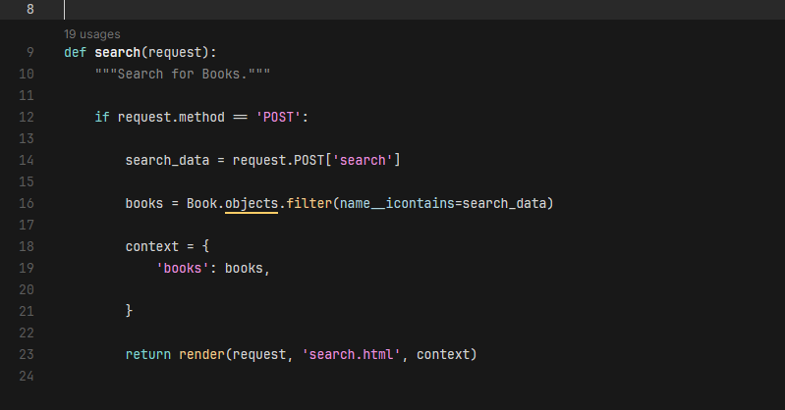
Search Functionality(View)
First, We check whether the request is POST
We store the searched data in a variable searched_data
We query the database and return items whose name contain the searched value.
Doesn't care whether capita or small letters

Slide 8
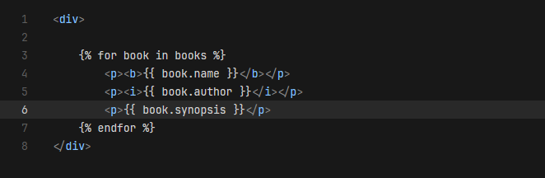
Search Functionality(Template)
We loop into the list containing queried items(queryset)
Return the books in the format:
Book name(bold)
Author(italics)
synopsis

Slide 9
Thanks for Watching
Like
Share
Subscribe

